Slide 1
Lesson 5 - Finding an Element in a List
Mr Mack 2019

Slide 2
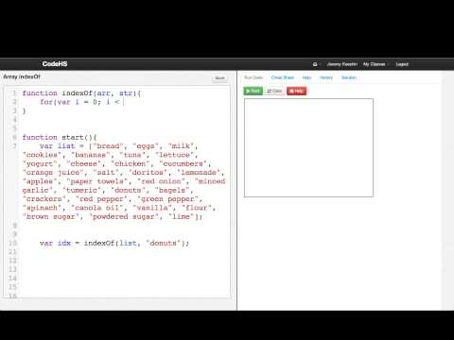
Finding an Element in a List

Slide 3
What method can we use to find the index of a particular element in an array?
indexOf
find
findElement
index

Slide 4
var groceries = ["milk", "eggs", "bread", "cheese", "yogurt", "sugar"];
What will be the result of groceries.indexOf("yogurt"); ?
true
false
4
5

Slide 5
var groceries = ["milk", "eggs", "bread", "cheese", "yogurt", "sugar"];
What will be the result of groceries.indexOf("cake"); ?
true
false
undefined
-1

Slide 6
Example: Array indexOf
This is an example for this lesson. You are encouraged to play around with it, run and change the code, and learn how it works. When you are done, click continue to go to the next problem.

Slide 7
Exercise 5.5.1: Who is in Line?
You are given an array of names of people who are in line. Try using if statements and the indexOf
method of arrays to see if Bob is in line.
var line = ["Sam", "Lisa", "Laurie", "Bob", "Ryan"];
var line2 = ["Tony", "Lisa", "Laurie", "Karen"];
You should print whether Bob is in each line. Your console should look print something like this:
Bob is in the first line.
Bob is not in the second line.

